Slide 1

UNIVERSITY OF AGRICULTURAL SCIENCES, BANGALORE — COLLEGE OF AGRICULTURE, GKVK
Fertilizer Recommendation Based on Temperature,Humidity,Soil moisture,Soil Type,
Crop Type and NPK
EAI421 — APPLICATION OF ARTIFICIAL INTELLIGENCE AND MACHINE LEARNING
Sindhushree K (AMB2250) | Suma K M (AMB2271)
VI B.Sc. (Hons.) Agriculture — COA, GKVK, Bangalore-65
Guide: Dr. Sailaja Thota
Course Teacher — Application of AI & ML

Slide 2
Agenda
01
Introduction
07
Data Preprocessing & Feature Scaling
02
Objective
08
Algorithms Used
03
Literature Review
09
Results & Model Evaluation
04
Problem Statement
10
Visualization & Confusion Matrix
05
Dataset Description
11
Limitations & Conclusion
06
Methodology
EAI421 – Application of AI & ML | UAS Bangalore-560065

Slide 3
Chapter 1: Introduction
Why This Project?
System At a Glance
Agriculture is critical to global food security and developing economies.
Overuse / misuse of fertilizers leads to soil degradation, water pollution & high costs.
World population projected to reach 10 billion by 2050 — demand for food is unprecedented.
Farmers lack precise guidance on soil-specific nutrient requirements.
Machine Learning can analyse multiple variables simultaneously for smarter decisions.
INPUT
FEATURES
Temp · Humidity · Moisture
Soil Type · Crop Type
N, P, K Levels
ML
MODELS
Decision Tree · Random Forest
Logistic Regression · ANN
OUTPUT
FERTILIZER
Urea 46-0-0 · DAP · MOP
10-26-26 · 14-35-14
EAI421 – Application of AI & ML | UAS Bangalore-560065

Slide 4
Chapter 2: Objective
Primary Objective
Design and implement a machine learning-based Fertilizer Recommendation System that accurately predicts the most suitable fertilizer type by analysing key soil and environmental parameters, enabling precision agriculture practices that maximise crop yield and support sustainable farming.
01
Compare 4 ML algorithms on the same dataset to identify the best-performing model
02
Apply preprocessing — Label Encoding + StandardScaler — for fair evaluation
03
Use GridSearchCV hyperparameter tuning to optimise Decision Tree performance
04
Provide interpretable, data-driven fertilizer decisions for precision agriculture
05
Evaluate models using Accuracy, Precision, and Recall metrics
05
EAI421 – Application of AI & ML | UAS Bangalore-560065

Slide 5
Chapter 3: Literature Review
10 recent studies (2024–2025) reviewed
Author(s)
Year
Algorithm / Method
Key Finding
Relevance
Sharma et al.
2024
RF & Gradient Boosting
91.3% accuracy
Validates ensemble methods
Patel & Kumar
2024
LSTM & MLP
MLP > LSTM for static data
Justifies ANN inclusion
Nguyen et al.
2024
DT, SVM, k-NN, Naive Bayes
>89% for DT & SVM
Benchmark for DT comparison
Ramesh & Priya
2025
RF + SHAP
N & Soil Type most influential
Supports explainability
Zhang et al.
2025
CNN-LSTM Hybrid
93.7% (greenhouses)
Future direction
Kulkarni & Desai
2024
LightGBM, XGBoost
F1 = 0.927
Boosted trees baseline
Fernandes et al.
2025
IoT + Random Forest
88.9% in field trials
Real-world applicability
Verma & Singh
2024
Bayesian vs GridSearchCV
Bayesian faster
Informs GridSearchCV usage
Key Finding: Decision Trees & ensemble methods consistently outperform others in fertilizer recommendation tasks.
EAI421 – Application of AI & ML | UAS Bangalore-560065

Slide 6
Chapter 4 & 5: Problem Statement & Dataset
Problem Statement
Farmers frequently apply fertilizers without precise soil/crop knowledge, leading to over-fertilization, nutrient deficiency, poor yields, high production costs, and environmental damage. Existing advisory systems lack scalability and fail to integrate multiple variables simultaneously. This project addresses the need for an automated, multi-feature ML system capable of recommending the right fertilizer from real-time data.
Dataset — Fertilizer Recommendation (Kaggle) | 75% Train : 25% Test | random_state = 0
Temperature (°C)
15 – 45°C
Influences enzyme activity
Humidity (%)
30 – 90%
Controls soil moisture indirectly
Soil Moisture (%)
20 – 65%
Affects nutrient solubility
Soil Type
5 categories (encoded 0–4)
Black, Clayey, Loamy, Red, Sandy
Crop Type
9 categories (encoded 0–8)
Barley, Cotton, Groundnut, etc.
Nitrogen (kg/ha)
Varies
Primary macronutrient
Phosphorus (kg/ha)
Varies
Critical for root development
Potassium (kg/ha)
Varies
Plant health & disease resistance
Recommended Fertilizer ★
TARGET — 5 classes
Urea 46-0-0, DAP, MOP, 10-26-26, 14-35-14
EAI421 – Application of AI & ML | UAS Bangalore-560065

Slide 7
Chapter 6: Methodology
10-Step ML Pipeline
01
Data Collection
h
02
Data preprocessing
03
Label Encoding
04
Feature Selection
05
Train-Test Split
Kaggle Fertilizer Dataset via Pandas
Handling missing values and formatted for analysis
Soil Type (5) & Crop Type (9) → integers
8 input features (X) + target (Y)
75% train / 25% test · random_state=0
06
Feature Scaling
07
Model Training
08
Hyperparameter Tuning
09
Model Evaluation
10
Visualization
StandardScaler — Z-score normalization
DT · Logistic Reg · Random Forest · ANN
GridSearch CV - · 72 combos
Accuracy, Precision, Recall, Confusion Matrix
plot_tree, bar charts, sample prediction
EAI421 – Application of AI & ML | UAS Bangalore-560065

Slide 8
Chapter 7: Data Preprocessing & Feature Scaling
Label Encoding
StandardScaler: All Features → Mean ≈ 0, Std ≈ 1
Soil Type → 0–4
Black=0, Clayey=1, Loamy=2, Red=3, Sandy=4
Crop Type → 0–8
Barley=0, Cotton=1, Groundnut=2, Maize=3,
Millet=4, Paddy=5, Rice=6, Sugarcane=7, Wheat=8
Temperature (°C) | 15–45°C → Equalizes contribution
Humidity (%) | 30–90% → Equalize range
Soil Moisture (%) | 20–65% → Nutrient solubility
Soil Type (enc.) | 0–4 → Match numeric range
Crop Type (enc.) | 0–8 → Prevent index domination
Nitrogen (kg/ha) | Varies → Neutralize large values
Phosphorus (kg/ha)| Varies → Equal contribution
StandardScaler fit only on training data → prevent data leakage
Potassium (kg/ha) | Varies → Avoid suppression
EAI421 – Application of AI & ML | UAS Bangalore-560065

Slide 9
Chapter 8: Algorithms Used
Five model configurations compared
Decision Tree (Original) ★
criterion='entropy', max_depth=None,
min_samples_split=5, min_samples_leaf=2
Recursively splits data on entropy (information gain). Highly interpretable and fast. Best model with 92.11% accuracy.
Scikit-learn
Decision Tree (Tuned)
criterion='gini', max_depth=None,
min_samples_split=2, min_samples_leaf=1
Hyperparameters optimised via GridSearchCV with -3fold CV over 72 combinations. CV accuracy 98.20%.
Scikit-learn + GridSearchCV
Random Forest
n_estimators=200, criterion='entropy'
Ensemble of 200 decision trees. Majority voting reduces variance vs single tree. 86.84% accuracy.
Scikit-learn
Logistic Regression
max_iter=1000
Linear model estimating class probabilities via softmax. L2 regularization prevents overfitting. 71.05% accuracy.
Scikit-learn
ANN — MLP Classifier
hidden_layers=(6,6), activation='relu',
max_iter=1000
Two hidden layers (6 neurons each). Did not converge within 1000 iterations. 65.79% accuracy.
Scikit-learn
EAI421 – Application of AI & ML | UAS Bangalore-560065

Slide 10
Chapter 9: Results & Model Evaluation
Model
Accuracy
Precision
Recall
DT Original ★
92.11%
91.75%
92.11%
DT Tuned
89.47%
88.28%
89.47%
Random Forest
86.84%
79.47%
86.84%
Logistic Reg.
71.05%
69.34%
71.05%
ANN (MLP)
65.79%
63.16%
65.79%
.
EAI421 – Application of AI & ML | UAS Bangalore-560065

Slide 11
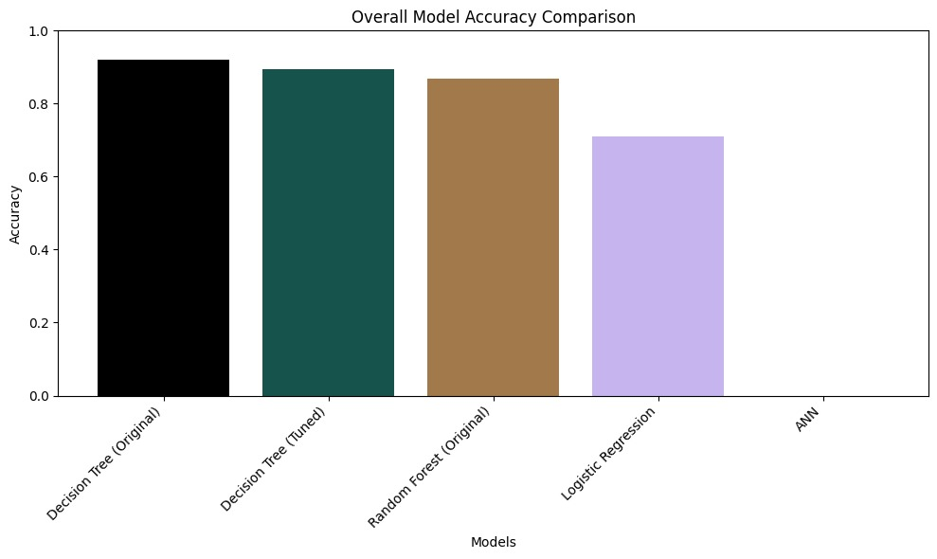
Figure 9.1-Model accuracy camparison graph

Slide 12
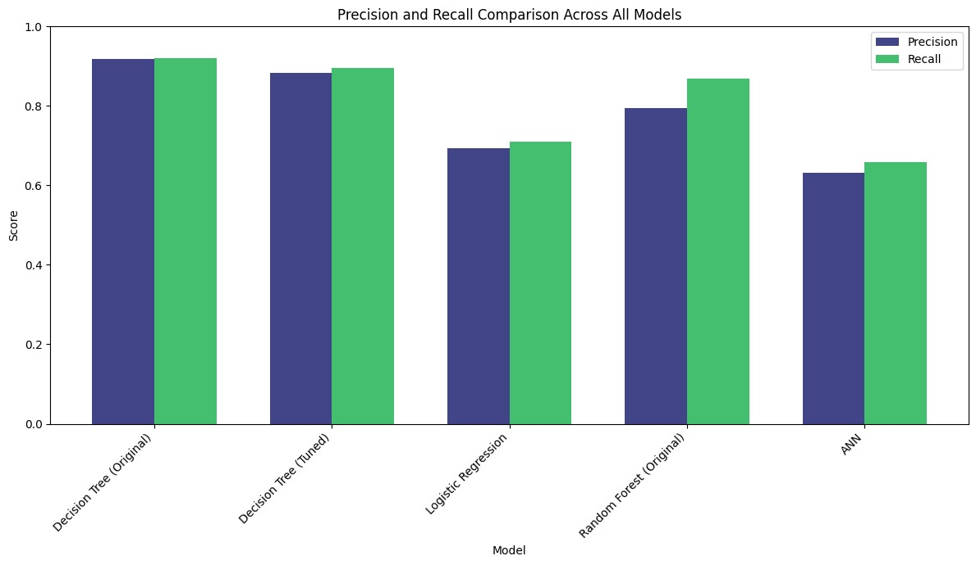
figure 9.2- precision and recall camparision graph

Slide 13
Chapter 10: Visualization — Confusion Matrix & Decision Tree
Confusion Matrix — Decision Tree (Original)
Decision Tree Visualization & Key Findings
Cls 0
Urea
Cls 1
DAP
Cls 2
MOP
Cls 3
10-26
Cls 4
14-35
Decision Tree (Tuned) was visualized using
Scikit-learn's plot_tree with filled=True,
colour-coding each leaf by fertilizer class.
Cls 0
Urea
11
0
0
0
0
Key Splitting Features:
Cls 1
DAP
0
4
0
0
0
Nitrogen (N)
Potassium (K)
Phosphorus (P)
Temperature
Cls 2
MOP
0
0
2
2
0
Precision & Recall Comparison
Cls 3
10-26
0
0
1
8
0
DT Original ★
P: 91.75%
R: 92.11%
DT Tuned
P: 88.28%
R: 89.47%
Cls 4
14-35
0
0
0
0
10
Random Forest
P: 79.47%
R: 86.84%
✓ Diagonal = Correct predictions ✗ Off-diagonal = Misclassifications
Minor confusion between Class 2 (MOP) and Class 3 (10-26-26) only
Logistic Reg.
P: 69.34%
R: 71.05%
EAI421 – Application of AI & ML | UAS Bangalore-560065

Slide 14
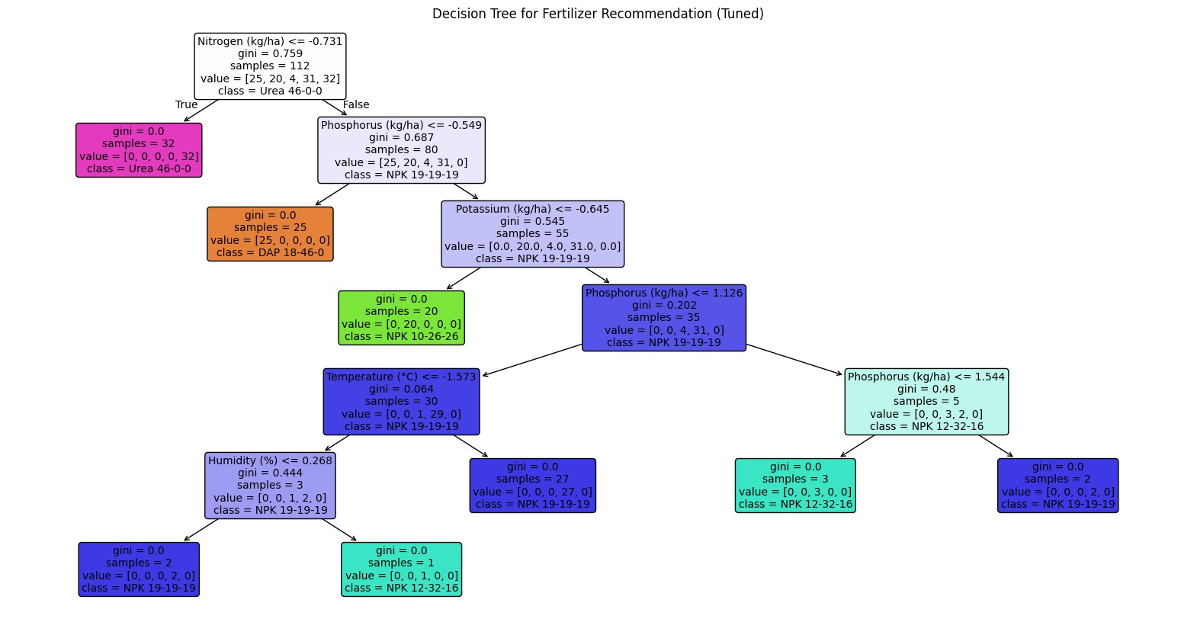
figure9.1 -Decision tree flow chart

Slide 15
Chapter 9: Hyperparameter Tuning — GridSearchCV
GridSearchCV Setup
Best Hyperparameters Found
Algorithm: Decision Tree Classifier
Total Combinations: 72 parameter sets
CV Accuracy Achieved: 98.20%
Test Accuracy: 89.47%
Parameter
Values Tested
Best Value
criterion
gini, entropy
gini
max_depth
None, 5, 10, 15
None
min_samples_split
2, 5, 10
2
min_samples_leaf
1, 2, 4
1
Insight
Although the tuned model achieved 98.20% cross-validation accuracy, the original Decision Tree (92.11% test) slightly outperformed it on unseen data, indicating the tuned model overfit the CV folds. Original model recommended for production.
EAI421 – Application of AI & ML | UAS Bangalore-560065

Slide 16
Chapter 11 & 12: Limitations & Conclusion
Limitations
Conclusion
Kaggle dataset may not fully represent real-world geographic diversity.
Small test set (25%) affects statistical reliability of metrics.
ANN (MLP) failed to converge within 1,000 iterations — needs more data/epochs.
No dynamic / real-time IoT or satellite data integration.
Fixed 5 fertilizer classes — cannot recommend custom blends or dosage amounts.
Best Model: Decision Tree (Original) — 92.11% Test Accuracy
GridSearchCV CV Accuracy: 98.20%
Label Encoding + StandardScaler are essential for fair evaluation.
Decision Tree provides interpretability valuable for agricultural advisory systems.
System offers scalable, data-driven precision agriculture with evidence-based decisions.
Future Work
Expand dataset with diverse geographical/seasonal records
Integrate IoT/satellite data for real-time inputs
Deploy as mobile/web app for farmers
EAI421 – Application of AI & ML | UAS Bangalore-560065

Slide 17
EAI421 — APPLICATION OF ARTIFICIAL INTELLIGENCE AND MACHINE LEARNING
Thank You!
Fertilizer Recommendation Based on Temperature, Rainfall,
Humidity, Soil Type, Crop Type and NPK
Sindhushree K (AMB2250) | Suma K M (AMB2271)
VI B.Sc. (Hons.) Agriculture — COA, GKVK, Bangalore-65
Guide: Dr. Sailaja Thota
Course Teacher — Application of AI & ML, COA, GKVK
University of Agricultural Sciences, Bangalore-560065 | Date: 15-04-2026

